Slide 1
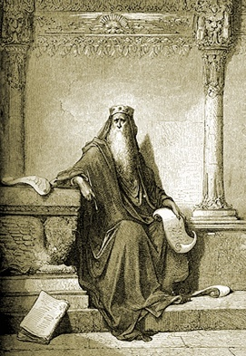
Ecclesiastes
Chapters 5-6

Slide 2
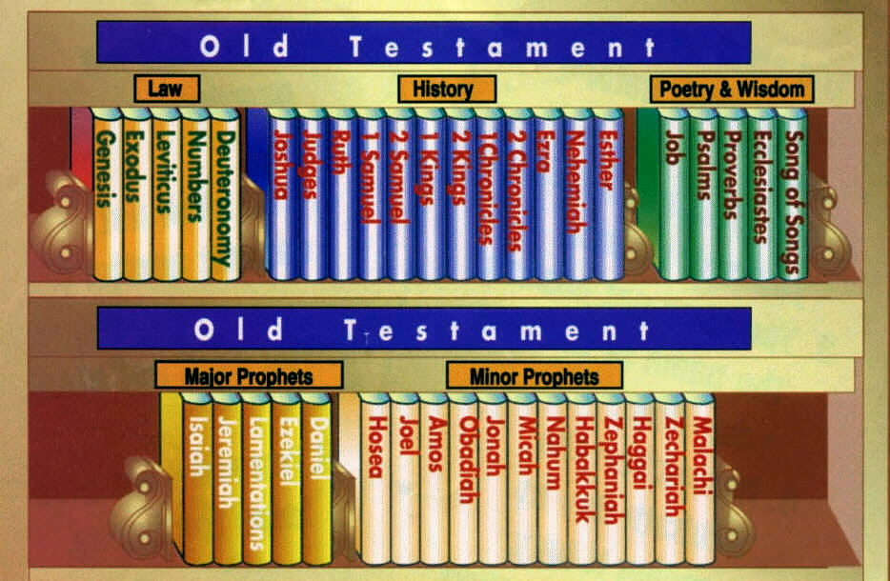
Part of the Wisdom Literature
Proverbs (collection of pithy sayings)
Ecclesiastes
Song of Solomon (love poems)
Bible Books

Slide 3
Ecclesiastes
Ch1-2: Vanity of the world and its pleasures
Ch 3-4: For every thing there is a season
Ch 5-6 Corruption of God's gifts
Ch 7-8: Wisdom of Preparations for Eternity
Ch 9-10 Walking in Divine wisdom
Ch 11-12 Diligence in seeking the Creator

Slide 4
Various Responses when you read this book
Vanity of Vanities !

Slide 5
Various Responses when you read this book
Vanity of Vanities !
^{(Ecc 1:2-3) 2} “Vanity of vanities,” says the Preacher; “Vanity of vanities, all is vanity.” ³ What profit has a man from all his labor in which he toils under the sun?
If we don’t have Him in our lives

Slide 6
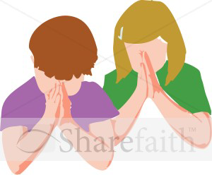

A Theme of Joy in Ecclesiastes!
^{(Ecc 8:15)} So I commended enjoyment, because a man has nothing better under the sun than to eat, drink, and be merry;
We have God in our lives

Slide 7
Ecclesiastes 5
Fear God and keep Your Vows
^{(Ecc 5:1)} Walk prudently when you go to the house of God; and draw near to hear rather than to give the sacrifice of fools, for they do not know that they do evil.

Slide 8

1. Let us go to the house of the Lord
^{(Ecc 5:1)} Walk prudently when you go to the house of God; and draw near to hear rather than to give the sacrifice of fools, for they do not know that they do evil.
^{(Ps 23:6)} Surely goodness and mercy shall follow me all the days of my life; and I will dwell in the house of the LORD Forever.
^{(Ps 73:14-17)} 14For all day long I have been plagued, and chastened every morning…17 Until I went into the sanctuary of God;

Slide 9

2. Let us listen
^{(Ecc 5:1)} Walk prudently when you go to the house of God; and draw near to hear rather than to give the sacrifice of fools, for they do not know that they do evil.
Contemplations from Abuna Tadros Yacoub Malaty:
Hearing is not a sign of humility.
Fools do not only speak but make mistakes not knowing they are doing mistakes.
Wise people when they do wrong they repent

Slide 10
2. Let us listen more
^{(Ecc 5:1)} Walk prudently when you go to the house of God; and draw near to hear rather than to give the sacrifice of fools, for they do not know that they do evil.
^{(Proverbs 1:33)} But whoever listens to me will dwell safely, And will be secure, without fear of evil.”
“Put your tongue to silence for your heart to speak, put your heart to silence for the Spirit in you to speak”
(St Gregory Bishop of Nieces)

Slide 11
3. Let us speak or read wisely
^{(Ecc 5:2)}Do not be rash with your mouth,
And let not your heart utter anything hastily before God.
For God is in heaven, and you on earth; therefore let your words be few.
What do we talk about in the morning when going to Church on a Sunday morning?
(Psalm 121) (from Sunset Prayer)
I was glad when they said to me, “Let us go into the house of the Lord;…”
(Psalm 14) (from 1st Hour Prayer)
Lord, who may abide in Your tabernacle? Who may dwell in Your holy hill? He who walks uprightly and works righteousness
and speaks the truth in his heart, he who
does not backbite with his tongue, nor does evil to his neighbor;…
(Psalm 83) (from 6th Hour Prayer)
How lovely is Your tabernacle, O Lord of hosts;…

Slide 12
4. Happiness in Ecclesiastes!
^{(Ecc 5:18)}Here is what I have seen: It is good and fitting for one to eat and drink, and to enjoy the good of all his labor in which he toils under the sun all the days of his life which God gives him; for it is his heritage.

Slide 13
5. Seriousness in Vows
^{(Ecc 5:4-5)}4 When you make a vow to God, do not delay to pay it; For He has no pleasure in fools.
Pay what you have vowed. 5 Better not to vow than to vow and not pay.
A later example the lie of Ananias and Sapphira (Acts 5:1-11)
Another example when King Hirodes promised Herodias to give her anything up to half the kingdom and she asked for the head of St John the Baptist.

Slide 14
6. Vanity of Gain and Honor
^{(Ecc 5:19)}As for every man to whom God has given riches and wealth, and given him power to eat of it, to receive his heritage and rejoice in his labor, this is the gift of God.
Are all rich people bad?
If not remember a good rich man from the Bible

Slide 15
Ecclesiastes Chapter 6
1. Wealth consumed by a foreigner:
^{(Ecc 6:1-2)}1 There is an evil which I have seen under the sun, and it is common among men: 2 A man to whom God has given riches and wealth and honor, so that he lacks nothing for himself of all he desires; yet God does not give him power to eat of it, but a foreigner consumes it.
2. Feeling of need in spite of the wealth:
^{(Ecc 6:6-7)} 6 even if he lives a thousand years twice—but has not seen goodness. Do not all go to one place? 7 All the labor of man is for his mouth, And yet the soul is not satisfied.
3. There is life after death:
^{(Ecc 6:12)} For who knows what is good for man in life, all the days of his vain life which he passes like a shadow? Who can tell a man what will happen after him under the sun?

Slide 16
Ecclesiastes 5-6
Practice;…
Take one person who is difficult for you & do one thing that will give him/her a glimpse of God’s love

Slide 17
Ecclesiastes 5-6
^{(Mat 5:44)} “But I say to you, love your enemies, bless those who curse you, do good to those who hate you, and pray for those who spitefully use you and persecute you”
This is what makes us Christians different from others;…

Slide 18
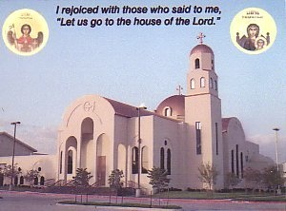
May the blessings of St. Mary , Archangel Michael,
St. Anthony, St. Paul the Hermit, St. George, all the Saints and all the martyrs be with us all. Amen

